Slide 1

The National University of Computer and Emerging Sciences
Introduction to Functions
CS 1002 Programming Fundamentals
Dr. Akhtar Jamil
Department of Computer Science

Slide 2
Goals
Review Of Previous Lecture
Introduction to Functions

Slide 3
Previous Lecture

Slide 4
Functions in C++
It is better to develop and maintain large programs in the form of smaller pieces (modules)
This technique Called “Divide and Conquer”
Better Development Approach
A Development Approach
Easier To >>
Design
Debug
Extend
Modify
Understand
Reuse
main()
{
-----
----
}
function f1()
{
---
---
}
function f2()
{
---
---
}
main()
{
-----
-----
-----
-----
.
.
.
----
-----
-----
return 0;
}

Slide 5
Functions in C++(Cont.)
In C++ modules Known as Functions & Classes
Programs may use new and “prepackaged” or built-in modules
New: programmer-defined functions and classes
Prepackaged: from the standard library

Slide 6

Calling Function
Function calls:
Provide function name and arguments (data); Function performs operations and; Function returns results

Slide 7
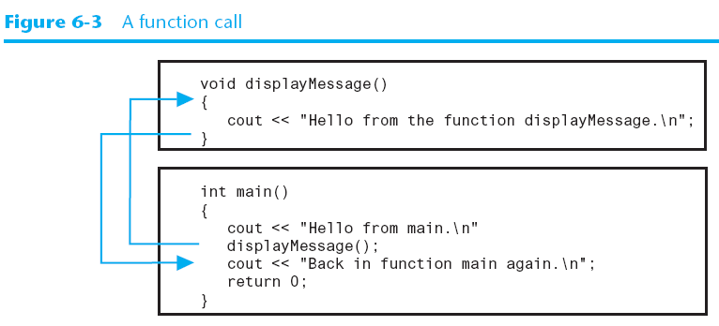
Calling Function

Slide 8
Calling Functions
Functions calling (Syntax):
<function name> (<argument list>);
e.g., FunctionName( );
FunctionName(argument1); FunctionName(argument1, argument2, …);
. . .

Slide 9
Calling Functions
Examples (built-in, and user-defined functions)
int n = getPIValue( ) ; //takes no argument
cout << sqrt(9); //takes one argument, returns square-root
cout<<pow(2,3); //calculates 2 power 3
cout<<SumValues(myArray); //returns sum of the array
A user-defined function
A user-defined function

Slide 10
Function Definition
Syntax for function definition:
returned-value-type function-name (parameter-list)
{
Declarations of local variables and Statements;
…
}
Parameter list
Comma separated list of arguments
Data type needed for each argument
If no arguments → leave blank
Return-value-type
Data type of result returned (use void if nothing will be returned)

Slide 11
Function Prototype
Before a function is called, it must be declared first.
Functions cannot be defined inside other functions
A function prototype is a function declaration without implementation:
int multiplyTwoNums(int,int);
A Function prototype (declaration without implementation)

Slide 12
Function Prototype (cont.)
int main() {
int sum = AddTwoNumbers(3,5);
cout<<sum;
return 0;
}
int AddTwoNumbers(int a, int b) {
int sum = a+b;
return sum;
}
Error: Un-defined function

Slide 13
Function Prototype (cont.)
Solution-1 Solution-2
int AddTwoNumbers(int a, int b) {
int sum = a+b;
return sum;
}
int main() {
int sum = AddTwoNumbers(3,5);
cout<<sum;
return 0;
}
int AddTwoNumbers(int, int);
int main() {
int sum = AddTwoNumbers(3,5);
cout<<sum;
return 0;
}
int AddTwoNumbers(int a, int b) {
int sum = a+b;
return sum;
}

Slide 14
Function signature and Parameters
Function signature is the combination of the function name and the parameter list.
Variables defined in the function header are known as formal parameters.
When a function is invoked, you pass a value to the parameter. This value is referred to as actual parameter or argument.

Slide 15
Function’s return values
c
A function may return a value:
returnValueType is the data type of the value the function returns.
If function does not return a value, the returnValueType is the keyword void.

Slide 16
void Functions
It isn’t necessary for all functions to return a value,
Some functions simply perform one or more statements, and then terminate.
These are called void functions.
void displayMessage()
{
cout << "Hello from the function displayMessage.\n";
}

Slide 17
Today’s Lecture

Slide 18
Calling Functions
c

Slide 19
Calling Functions
c
i is now 5

Slide 20
Calling Functions
c
j is now 2

Slide 21
Calling Functions
c
Call max(5, 2)

Slide 22
Calling Functions
c
Now num1=5 num2=2

Slide 23
Calling Functions
c
A new variable result will be created (local to the max function)

Slide 24
Calling Functions
c
5 > 2 → true condition

Slide 25
Calling Functions
c
result = 5

Slide 26
Calling Functions
c
return 5

Slide 27
Calling Functions
c
k = 5

Slide 28
Calling Functions
c
Display “The maximum between 5 and 2 is 5”

Slide 29
Calling Functions
c
main function ends

Slide 30
Exercise
Write a function to find Fibonacci series for a positive number N and print the series. If user enters 0 or one or negative number then display message “Invalid Input”.

Slide 31
Exercise
Write a function that calculates the person’s Body Mass Index (BMI). The BMI is often used to determine if a person is overweight, underweight for his/her height.
- Ask User to input his/her weight and height
BMI is calculated as:
BMI = (weight * 703) / (height*height)
Here weight is in pounds and height is in inches.
The program should display the message:
- “Optimal Weight” if BMI is 18.5—25
- “Under Weight” if BMI is < 18.5
- “Over Weight” if BMI is > 25

Slide 32
Exercise
Write a function to convert a decimal number into binary.

Slide 33
Function Overloading
c
Function overloading
Functions with same name and different parameters
Should perform similar tasks:
i.e., function to square int and function to square float values
int square(int x)
{ return (x * x); }
float square(float x)
{ return (x * x); }

Slide 34
Function Overloading
c
At call-time C++ complier selects the proper function by examining the number, type and order of the parameters

Slide 35
Function Overloading
c
void print(int i)
{ cout << " Here is int " << i << endl; }
void print(double f)
{ cout << " Here is float " << f << endl; }
void print(char c)
{ cout << " Here is char" << c << endl; }
int main()
{ print(10); print(10.10); print(‘Y’); }

Slide 36
Default Function Arguments
c
A value auto assigned by compiler (if not provided by user)
After default argument, all remaining function arguments must be default arguments
Example….

Slide 37
Default Function Arguments - Example
c
int sum(int x, int y, int w=1, int z=2) {
return (x+y+w+z);
}
int main() {
cout<<sum(2,3); //sum will be: 8
cout<<sum(2,3,4); //sum will be: 11
cout<<sum(2,3,4,5); //sum will be: 14
return 0;
}

Slide 38
Programing Problems
Write a function to convert an integer into binary number and print both binary and binary number. The function must accept only positive numbers.
Complete the following function to return true if the N is divisible by both a and b. otherwise return false.
bool IsDivisible(int N, int a, int b);
Write a function to find if a number if prime or not
bool IsPrime(int N);
Write a function to find prime factors of a number
bool PrimeFactor(int N);

Slide 39
References
Credit goes to Dr. Muhammad Aleem for preparation of slides
Chapter 6, Starting out with c++

Slide 40
Thank You ☺

